Slide 1
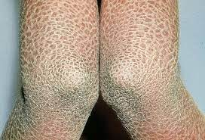
Ichthyosis

Slide 2
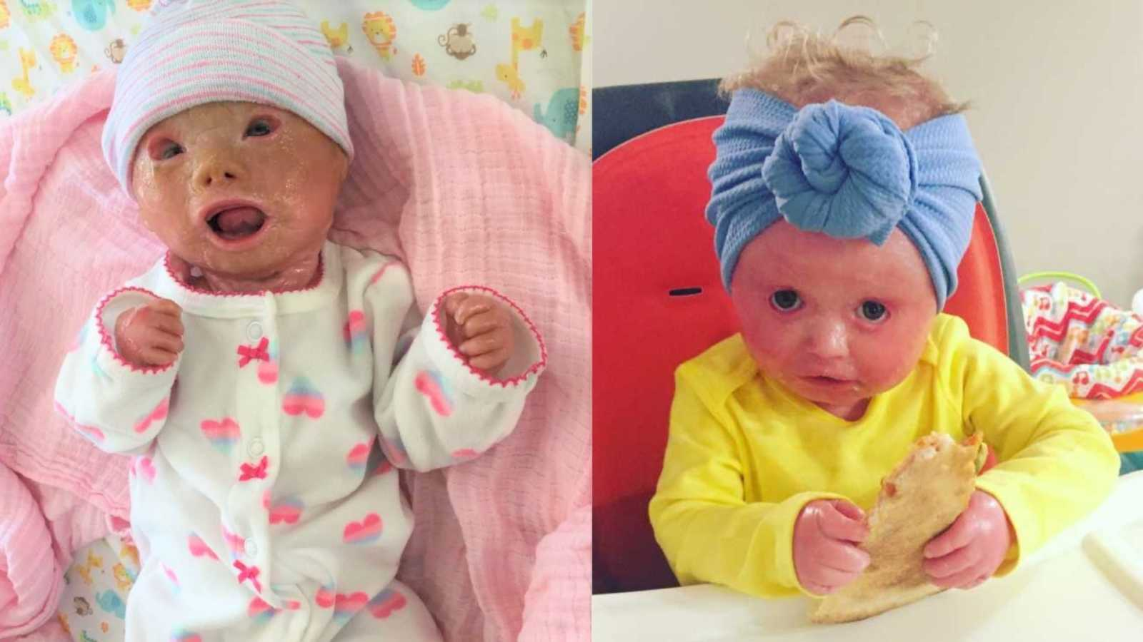
Ichthyosis is a general term for a wide spectrum of keratinization disorders. May be dermatologic only, or be secondary to renal disease, hypothyroid, sarcoidosis, Hodgkin’s Lymphoma, HIV, or other diseases of the internal organs. Gene dysfunction results in a barrier deficiency of the skin that leads to increased insensible loss. It’s speculated. that the hyperkeratosis seen in ichthyosis is an attempt to compensate.
Characterized by scaling, inflammation, and hyperkeratosis of the skin.
Genetic disorder that may occur in as many as 1 in 250 live births. (This number is for ichthyosis vulgaris, one of the most common variants; others, such as harlequin ichthyosis, are considerably more rare.)

Slide 3
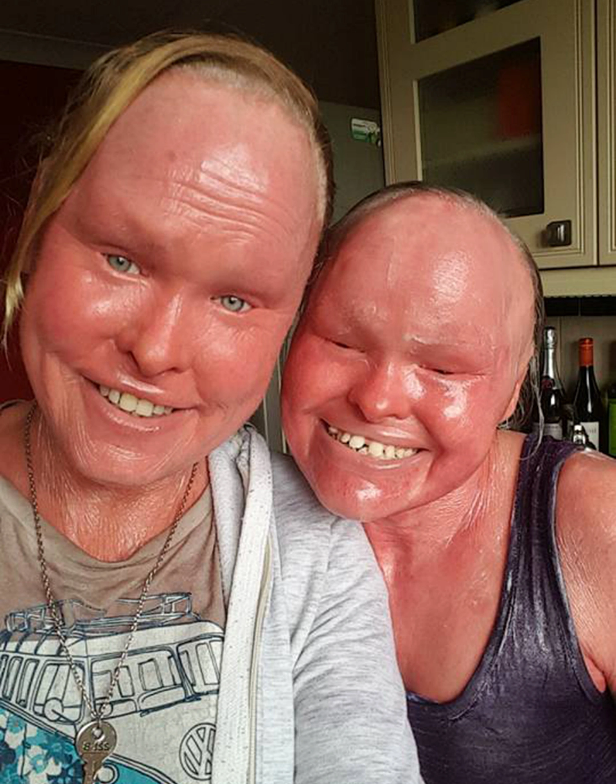
Family Medical History: As a genetic disorder, ichthyosis may show up in multiple members of a family.
Skin examination: Symptoms of non-syndromic ichthyosis typically appear between birth and 12 months. Clinical features include scaling of the skin, primarily on the torso, legs and buttocks.
Skin Biopsy: “Histopathologic patterns include orthohyperkeratosis with a reduced or well-developed stratum granulosum, hyperkeratosis with ortho- and parakeratosis with preserved or prominent stratum granulosum, and epidermolytic ichthyosis. Another pattern features ‘perinuclear vacuoles and binucleated keratinocytes’, which is associated with keratin mutations. Some ichthyoses are histologically defined by psoriasis-like features, and distinct subtypes show follicular hyperkeratosis. In addition to histological and immunohistochemical methods, these patterns allow a better histopathologic diagnosis.” (Metze et el, 2021)
Genetic testing: Ichthyosis is caused by a mutation in the filaggrin gene (FLG).
Pre-Natal Testing: Low maternal serum unconjugated estriol during pregnancy is an indicator of ichthyosis in the fetus. May also perform analysis on amniotic fluid.
Metze, D., Traupe, H., & Süßmuth, K. (2021). Ichthyoses—a clinical and pathological spectrum from heterogeneous cornification disorders to inflammation. Dermatopathology, 8(2), 107–123. https://doi.org/10.3390/dermatopathology8020017

Slide 4
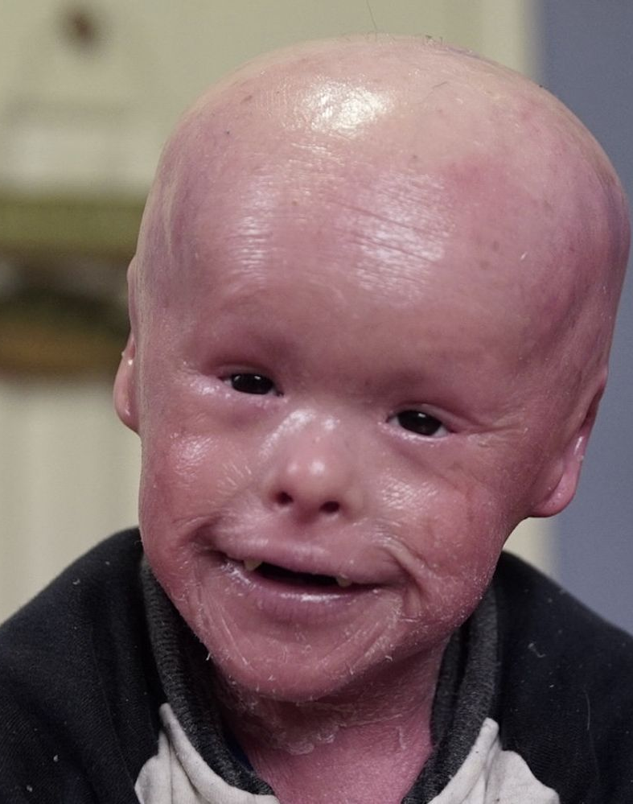
There is no cure for ichthyosis. Therapy focuses on managing the symptoms to maximize quality of life.
Patients are encouraged to rub emollients into the skin after a shower, then utilize a pumice stone to remove the thickened scales. See the chart on the following slide for current recommendations of emollient therapies. Water-based emollients are recommended for mild ichthyosis, paraffin based emollients for more severe variations.
Keratolytic Agents: 1-5% salicylic acid to facilitate exfoliation.
Alpha-hydroxy Acids: Lactate, glycolic, malic or other oils. Increase the water holding capabilities of the stratum corneum to facilitate exfoliation. Gentler than keratolytic agents.
Urea: Emollients containing urea also facilitate exfoliation.
Topical steroid creams may help reduce erythema associated with exfoliation.
Retinoids: Acitretin and isotretinoin are systemic retinoids (oral) and reduce scaling in patients with severe ichthyosis.
Antibiotics: Patients may require antibiotics to treat infections in skin fissures.
Clinical research is currently focusing on gene and protein modification therapies, as well as treatment with biologics.
Patients are encouraged to avoid cold, dry environments and skin irritants.
Sergeant, A., & Munro, C. (2006). Ichthyosis: Guide to recognition and current treatment options. Prescriber, 17(8), 35–42. https://doi.org/10.1002/psb.368

Slide 5
